Slide 1
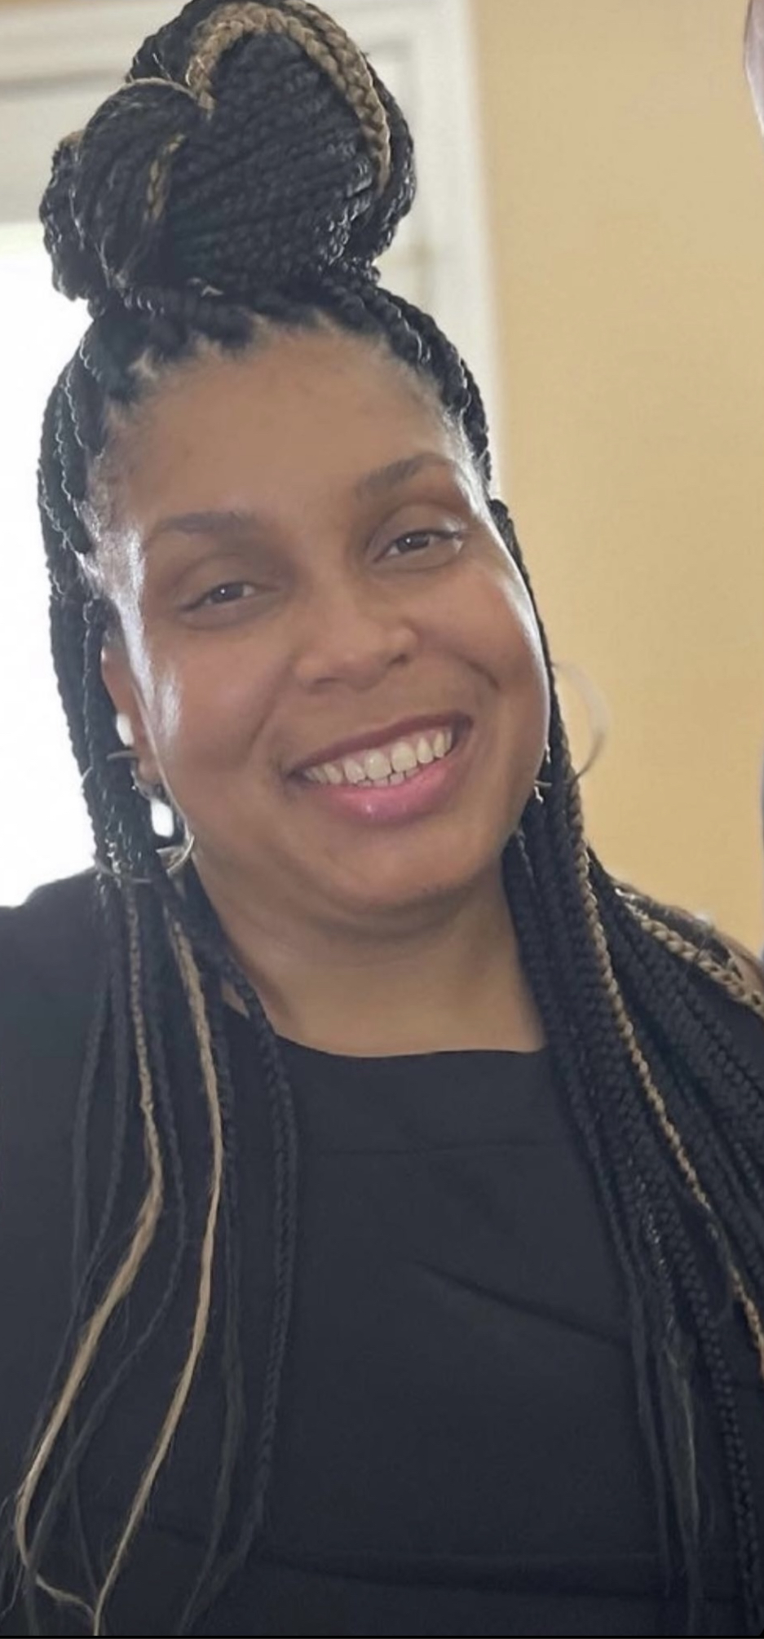
Mrs. Johnson
Welcome to Pre-Kindergarten 2023-2024 school year at Thompson Elementary! This is my fifth year at Thompson Elementary. My background includes a Bachelor’s degree in Sociology from University of Houston, and working with students of all levels, including Special Education. I am certified to teach EC- 6th grade. This year will be full of fun learning experiences. I’m so excited to get to know each one of you, especially since our classroom is truly one big family. This will be a great year and I can’t wait to meet YOU!
Cheesecake, Chick-fila, Seafood, Pasta, Macy’s, Target, Starbucks, Football, Traveling, Pink and Black.
Sandy.Johnson@houstonisd.org
(713)746-8250
Conference Period: 9:15 am to 10:15 am

